Slide 1
10Base-T1S PHY Hands-On Training
Setup Instructions

Slide 2
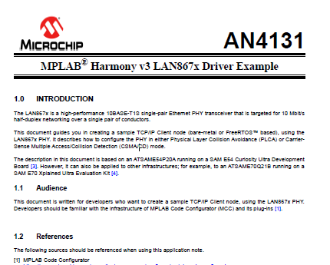
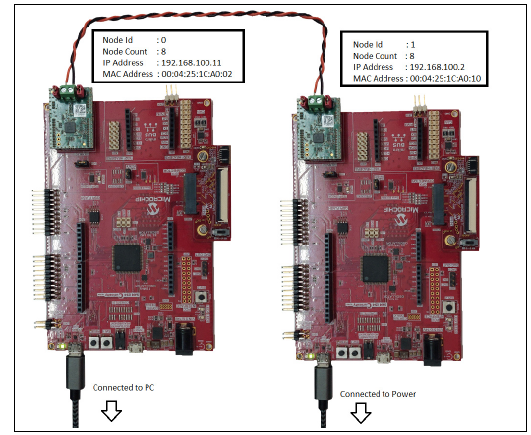
Goal of this Hands-On Training
Present a demonstration of an example of Single Pair Ethernet communication over 10BASE-T1S
Use LAN8670 RMII evaluation board with SAME54 Curiosity Ultra
Based on Application Note AN4131
Link to AN4131 is given here and is also available on LAN8670 Product Page
Notes:
The demo will show you how to build, from scratch, a project in Harmony 3 that will include the Harmony 3 TCP/IP software stack together with the driver for the 10BaseT1S PHY. Using two Microchip evaluation boards that I have with me today, I will then show you the TCP/IP communication link between the two evaluation boards which are connected to each other using a single twisted pair of wires, rather than a more usual CAT 5e or CAT 6e Ethernet cable. The evaluation boards that I am going to use today are a pair of identical boards which have the ATSAME54 32-bit Microcontroller, mounted with a 10BaseT1S PHY daughter board.
The TCP/IP stack will use the MAC module on the SAME54 to communicate over RMII with the PHY on the daughter board, which will then transmit the information over the twisted pair of wires to the PHY on the other board. This demonstration is based on an Application Note that is on the product page of the 10BaseT1S PHY, which is called LAN8670.
As part of the demonstration I am going to take you step by step through the creation of the project in Harmony 3, the configuration of the TCP/IP Stack, and the configuration of the driver for the 10BaseT1S PHY. Then we will generate the code in Harmony 3 and program each SAME54 device one at a time.

Slide 3
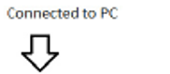
LAN8670 RMII evaluation board with SAME54 Curiosity Ultra
Ethernet Interface with RMII mounted with EVB-LAN8670-RMII to 10BASE-T1S interface card
ATSAME54P20A
On board EDBG debugger
USB Debugger Interface
Reset
Notes:
The evaluation boards are the SAME54 Curiosity Ultra boards which have a few useful development features on them. Here is a quick overview of the boards. The Microcontroller is the ATSAME54P20A which has a 32 bit Cortex M4 processor running up to 120MHz. This Microcontroller has a Layer 2 Ethernet GMAC capable of providing 10Mbps and 100Mbps data-rates with the RMII interface so that it can work with a Layer 1 Ethernet transceiver.
The MAC also provides a Medium Independent Interface Management (MIIM) bus for configuring the PHY, which will be used by the Harmony driver for the initial setup of the PHY. The evaluation board has an on-board debugging tool known as EDBG so as you will see we will be programming the SAME54 directly from the Harmony 3 application, without the need for an external, separate debugging tool. The on-board debugger is connected to the Harmony 3 application on the PC via a USB interface which can also be used to connect to the application running on the SAME54 for sending and receiving serial communication related to the TCP/IP stack. There are a number of options for providing power to this board, but this same USB interface can be used for this purpose, making it possible to use one USB interface for programming, power as well as the serial communication port. The board also features a Reset switch which we will be using as part of this application also.
You will notice that the PHY interface card does not look like the more usual Ethernet PHY that would typically be used for point-to-point Ethernet communication. Usually, the daughter board that would occupy this slot would have a 10, 100, or 1000BASE-T PHY populated on the board along with an RJ45 socket which would have a transformer integrated into it. The link would normally be provided using a CAT 5 or CAT 6 cable to another PHY, either standalone or on a switch. You will notice that this PHY is connected to the opposite board using a single unshielded twisted pair of wires, which are connected by screw connectors rather than an RJ45 socket. This is due to the fact that the LAN8670 is a 10BASE-T1S PHY which can be used to transmit information using a signal pair of unshielded twisted wires.

Slide 4
Project Setup
Step-by-Step Guide to Creating the Project

Slide 5
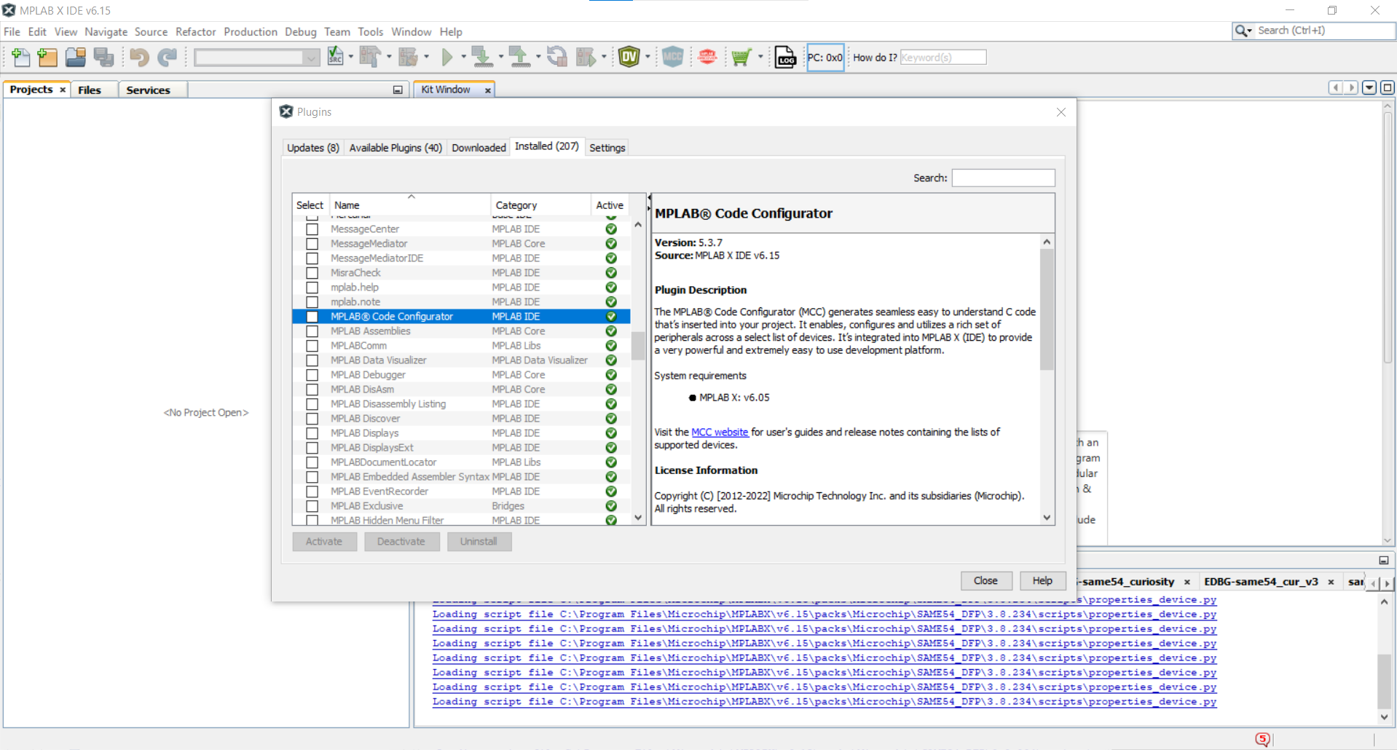
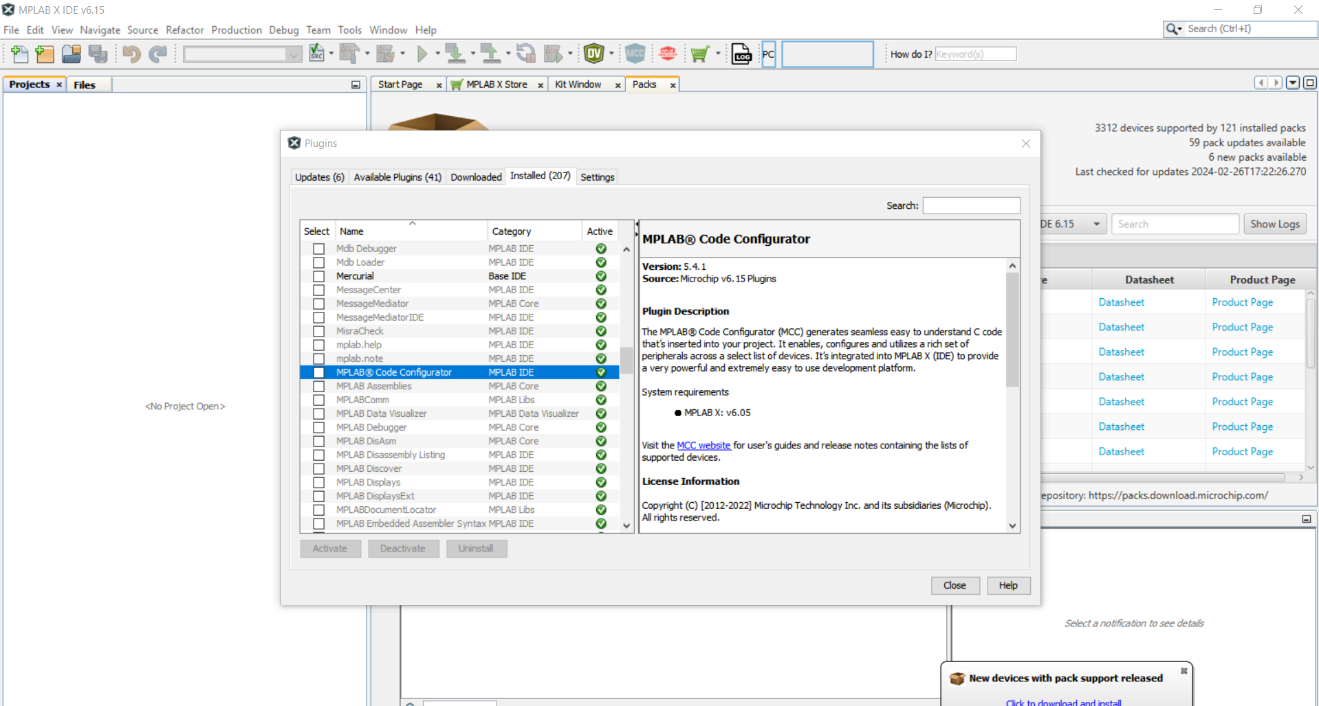
Step 1
Having opened MPLAB X IDE (See Useful Links and References) , in Tools > Plugins, check that you have MPLAB Code Configurator installed.
If it is not there, look in Available Plugins and install it from there.

Slide 6
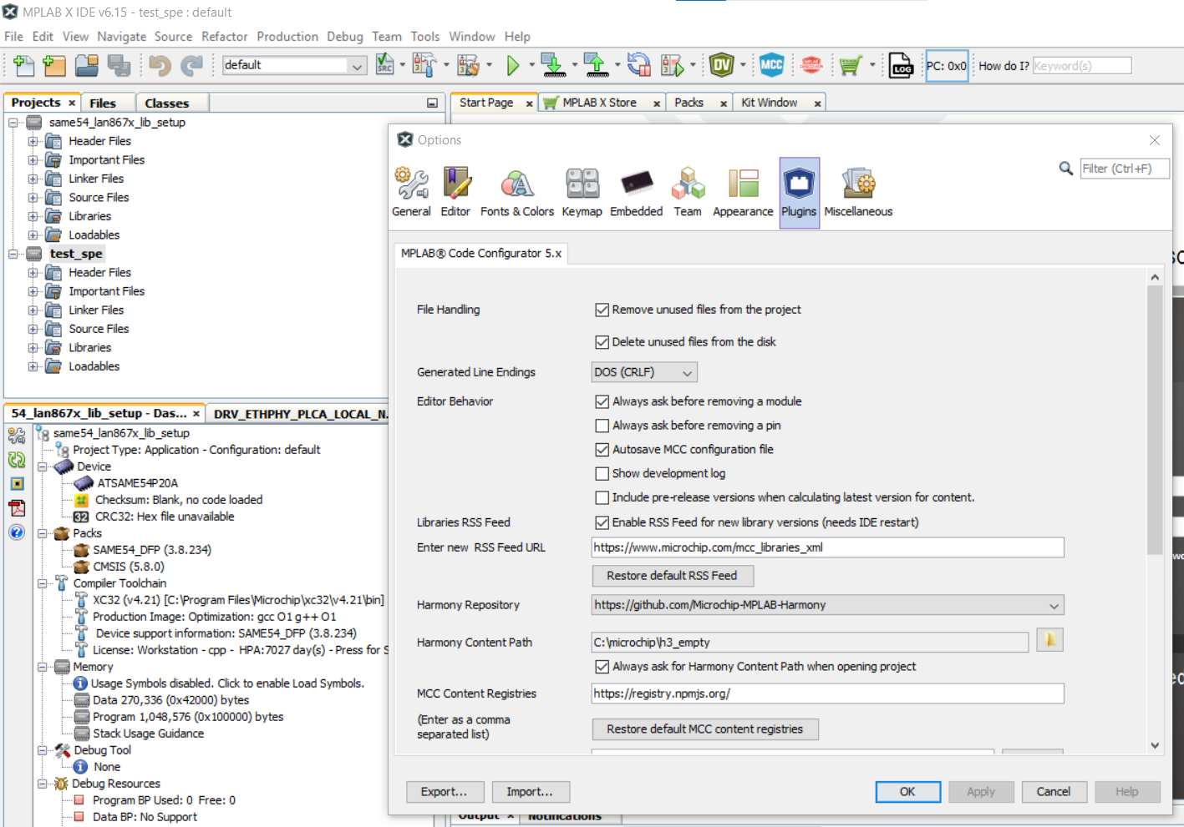
Step 2
In Tools > Options, go to the Plugins tab.
If you have not used Harmony in the past:
In your Folders on your PC you need to create an empty folder where all of the harmony libraries will be downloaded to. Having created this folder, put the folder location in the Harmony Content Path in as shown.
If you are a Harmony user:
if you have used Harmony before, you will have already created a repository for all of the libraries, and you can use this same folder for the purposes of this class.

Slide 7
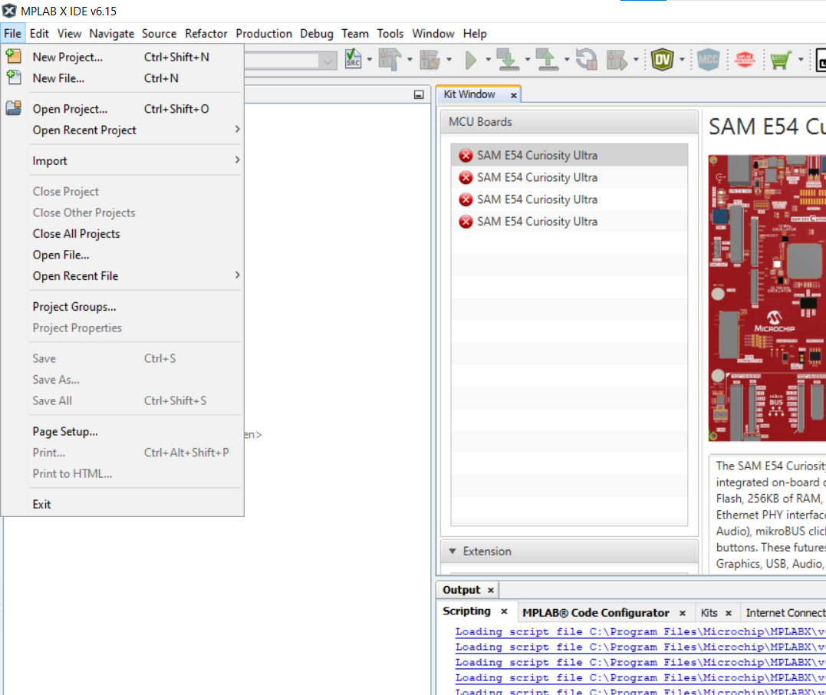
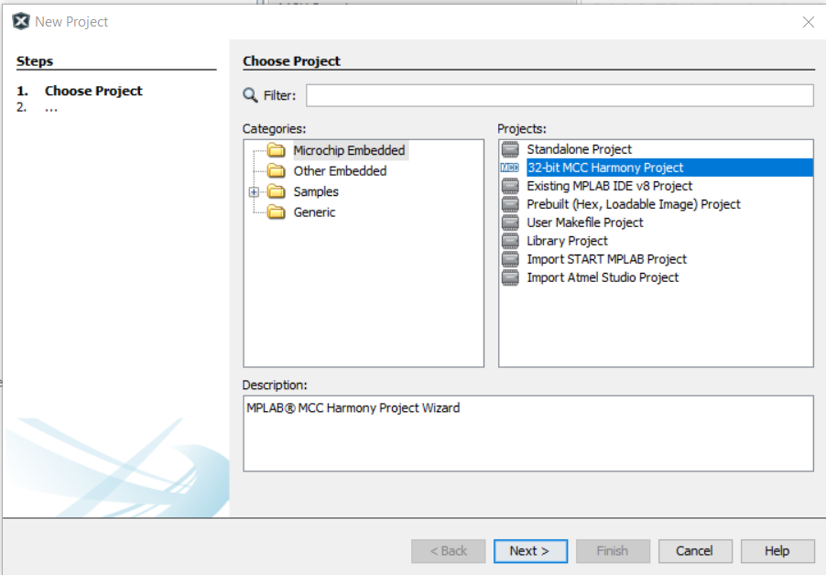
Step 3
In MPLAB X, go File > New Project…
Select 32-bit MCC Harmony Project and click Next>

Slide 8
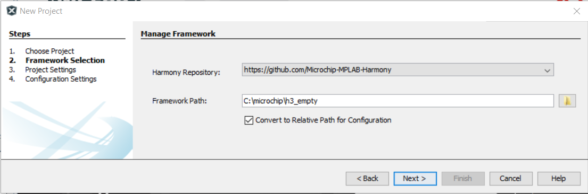
Step 4
The Framework Path needs to be the same as you specified in the Tools>Options>Plugins Harmony Content Path in the Step 2.

Slide 9
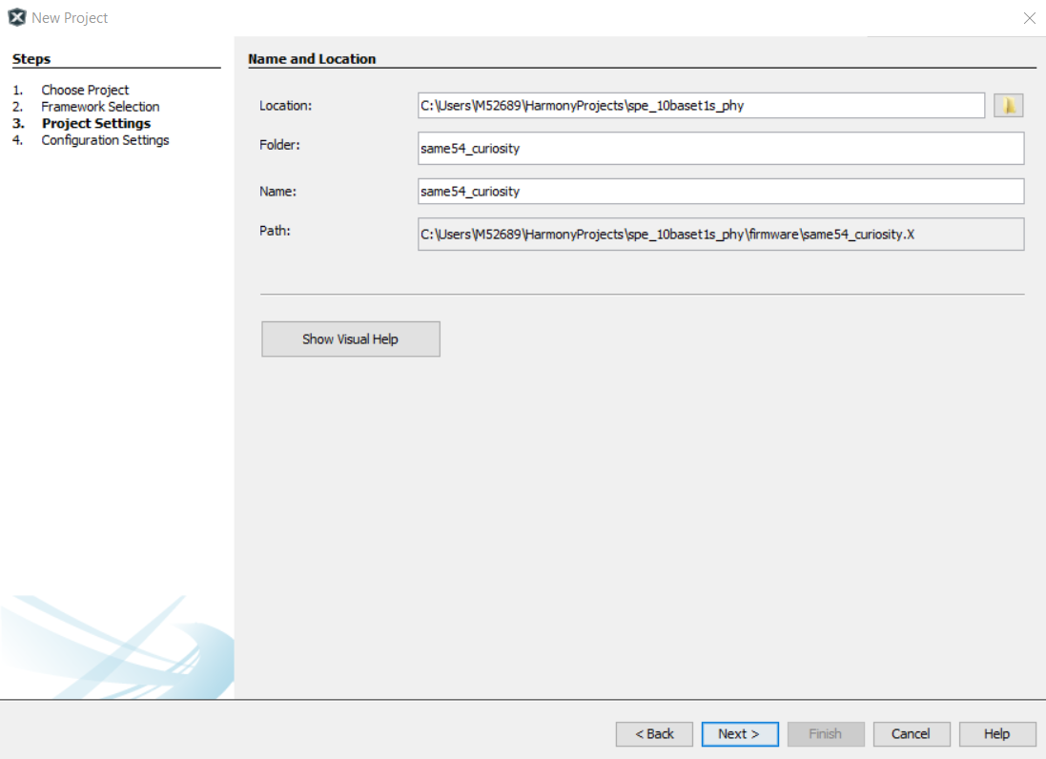
Step 5
Specify the Location, Folder and Name of your project (Tip – Show Visual Help is useful to understand the differences between these.)
Click Next >.

Slide 10
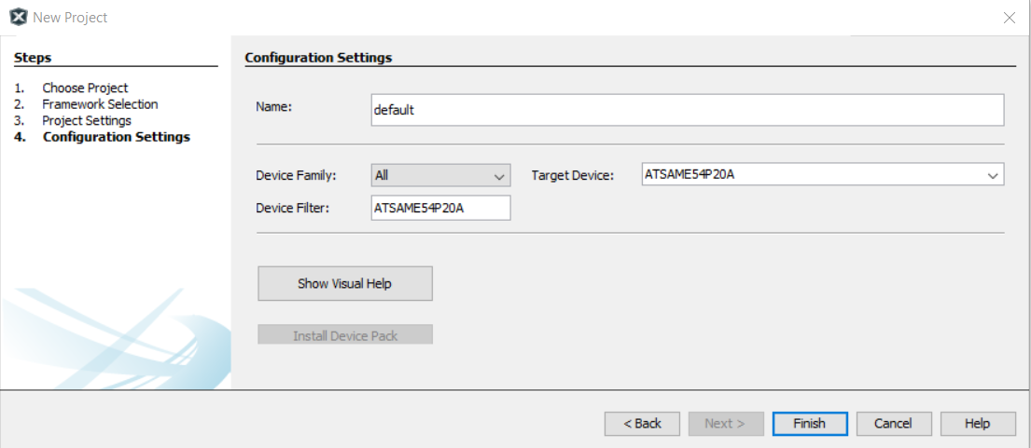
Step 6
Choose a Configuration Name (or leave it as default) and select the Device Family as ATSAM, and Target Device as ATSAME54P20A. (Tip: copy/paste ATSAME54P20A into the Device Filter and this will find the device quickly) Click Finish.

Slide 11
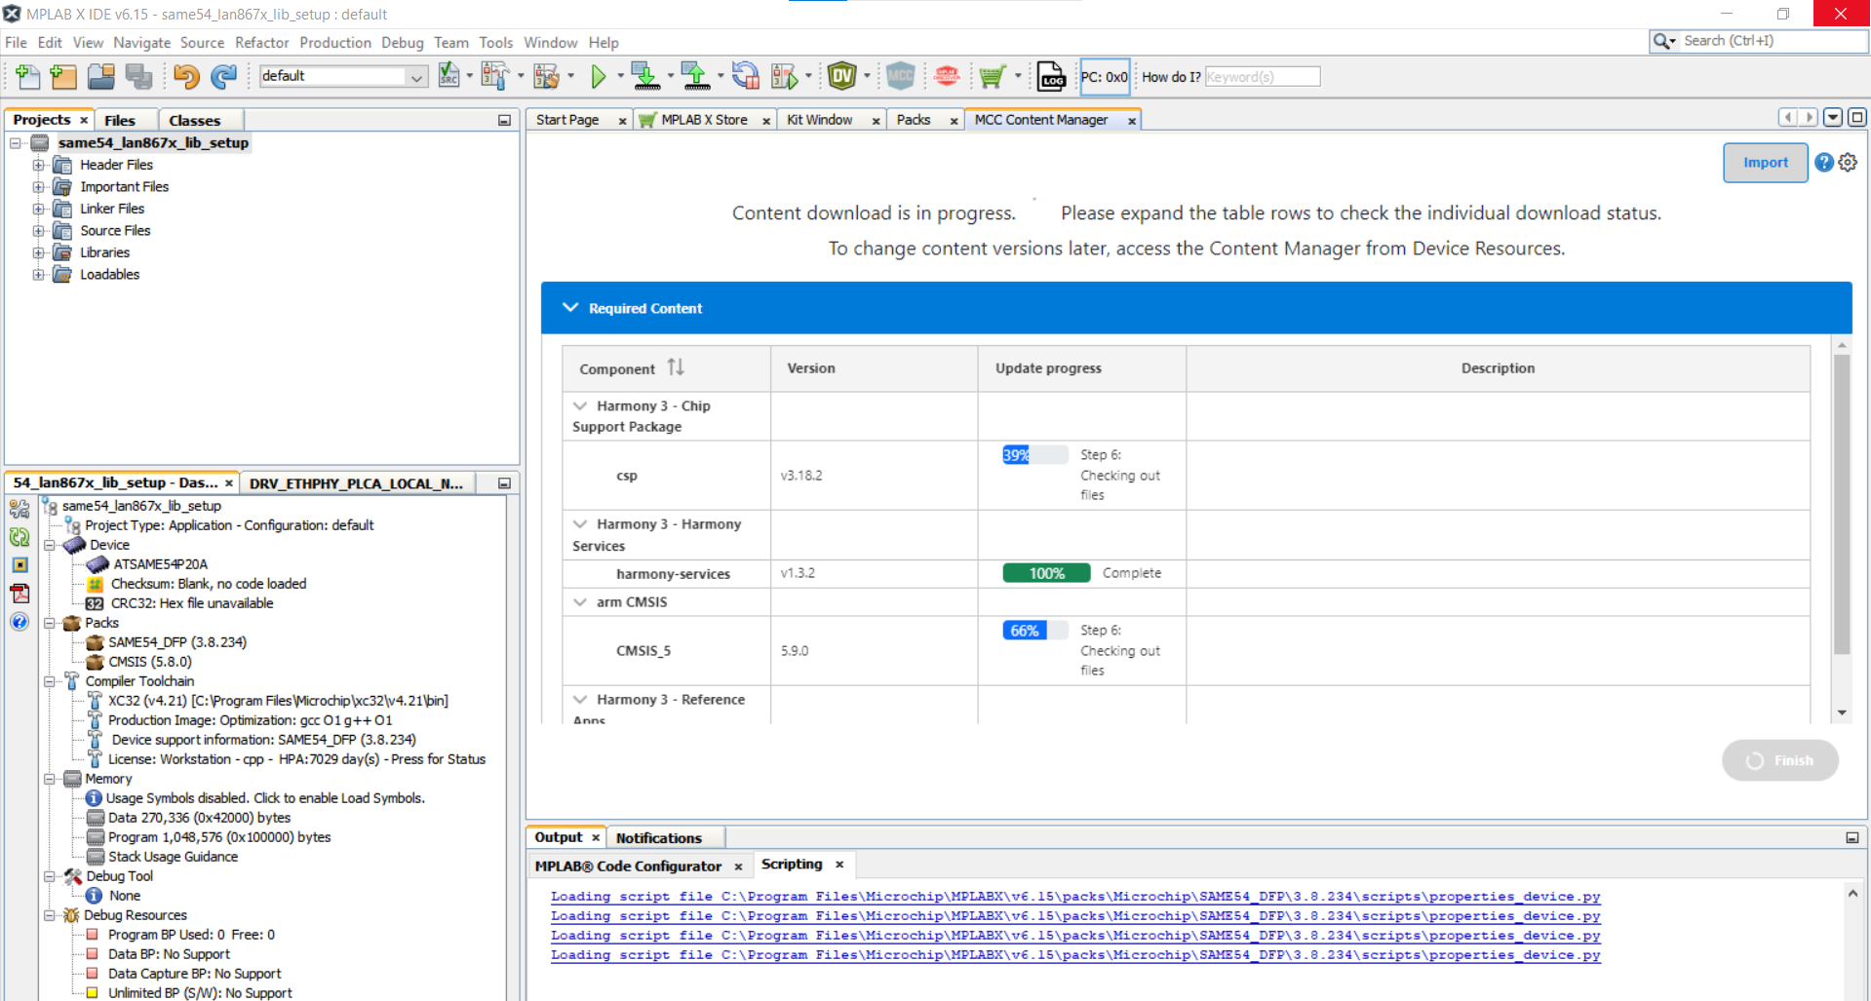
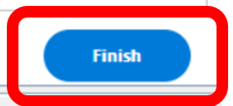
Download the Essential Libraries
If you have not downloaded the libraries before now, you will see a window like this, and you can click Finish to download the essential libraries for the device you have selected to use.

Slide 12
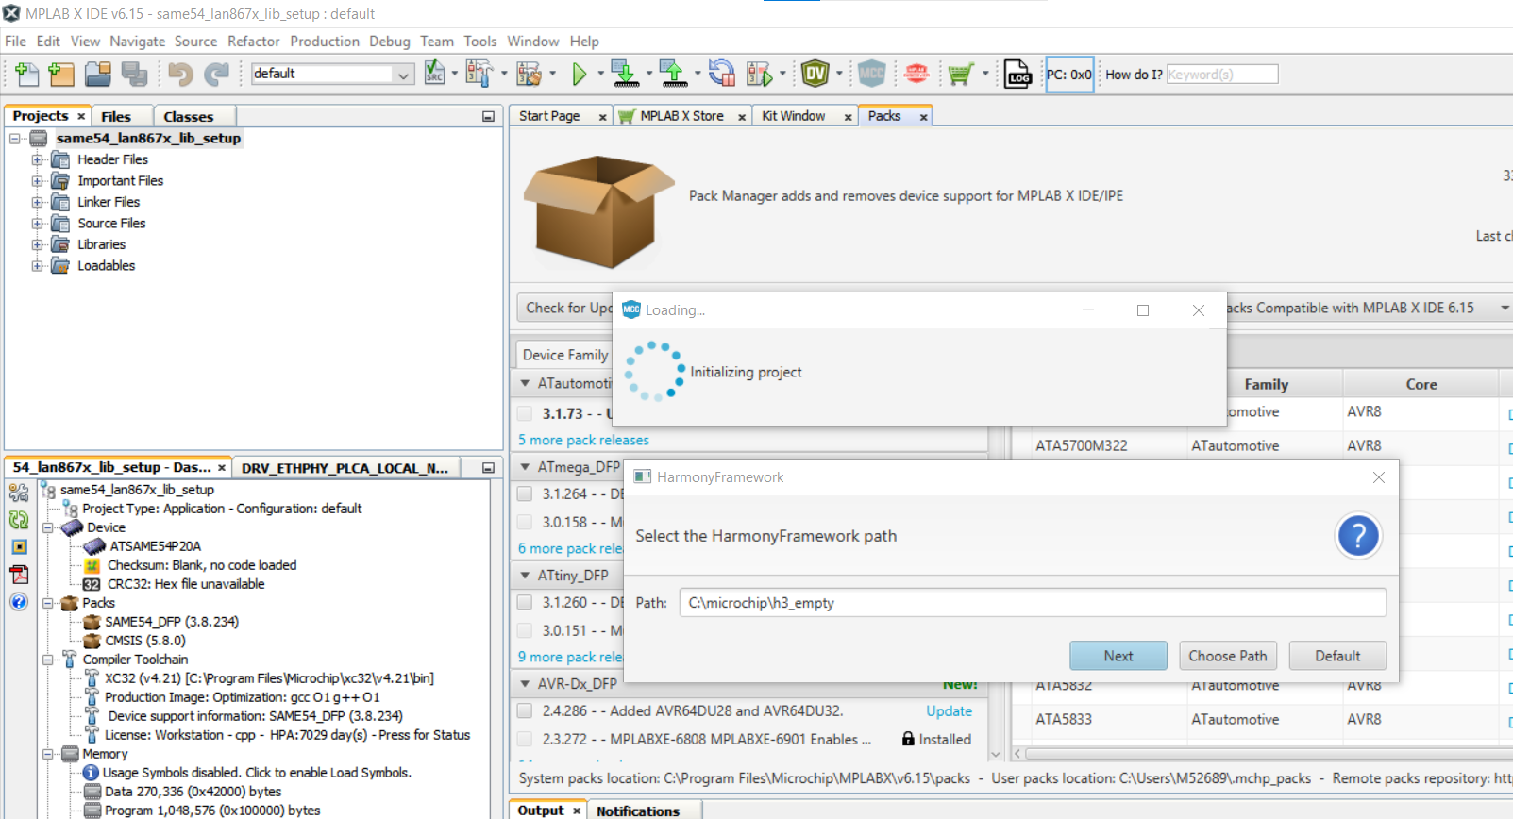
Approve the Harmony Framework Path

Slide 13
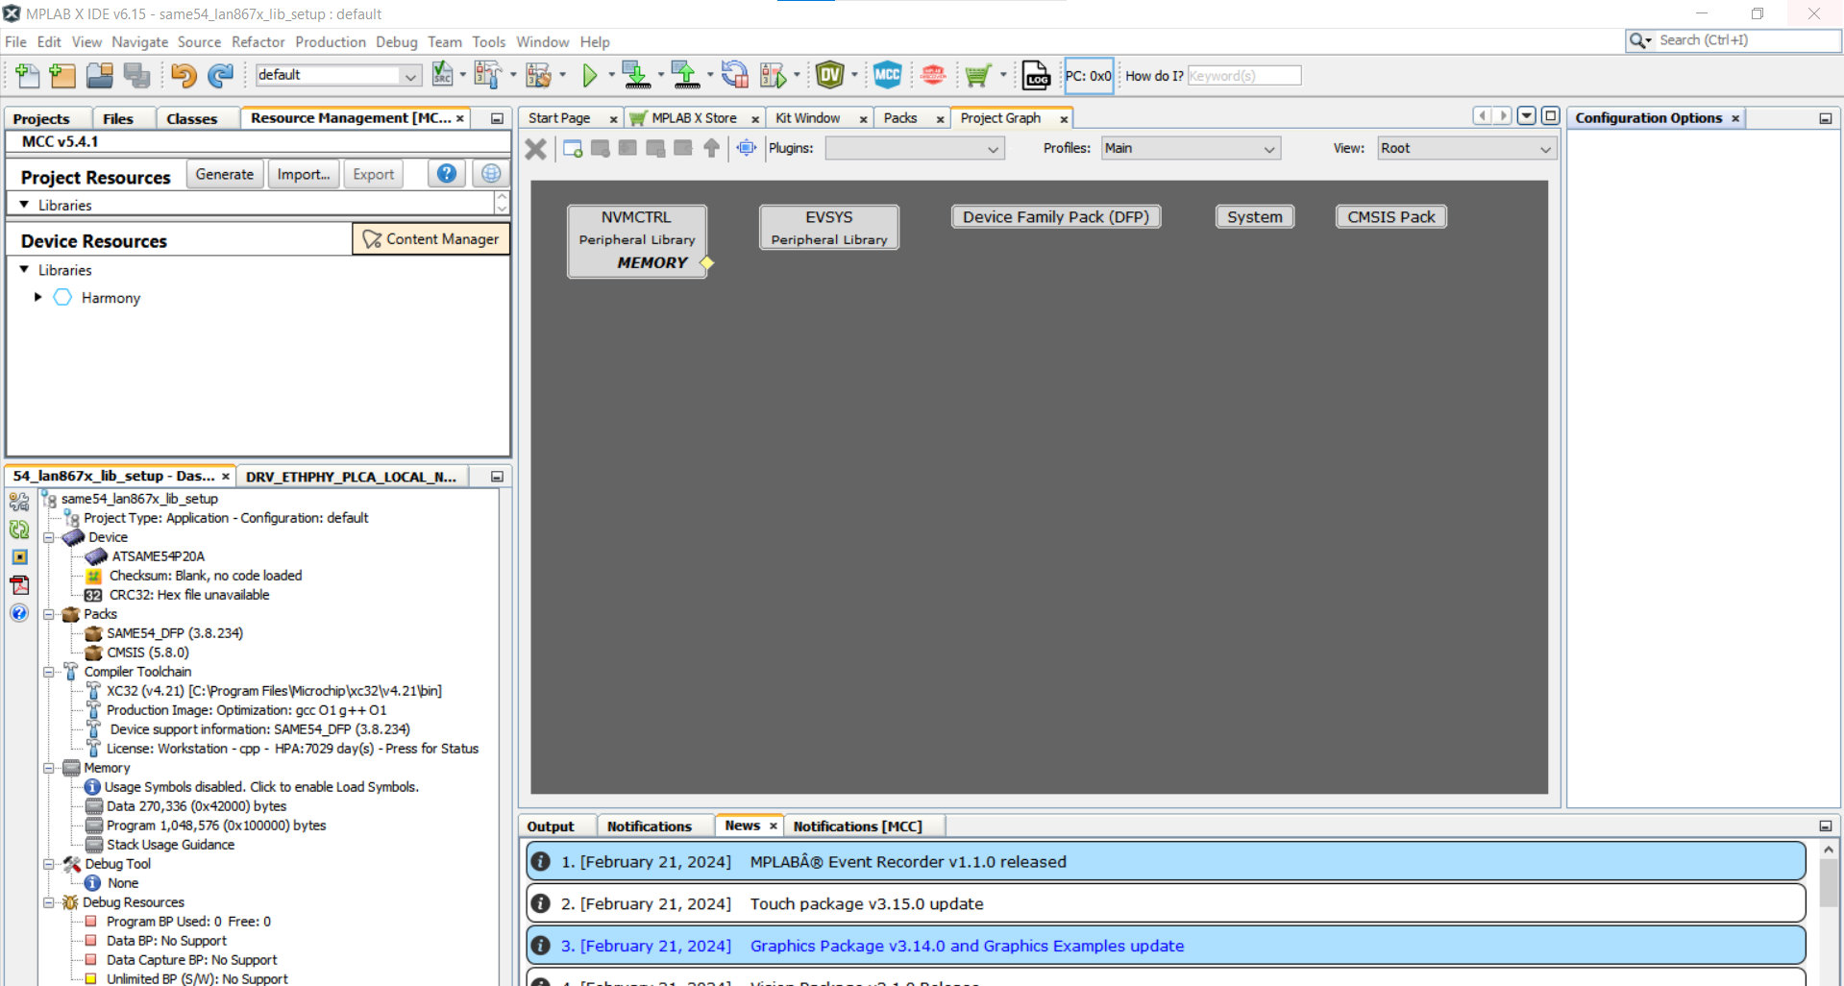
Open the Content Manager

Slide 14
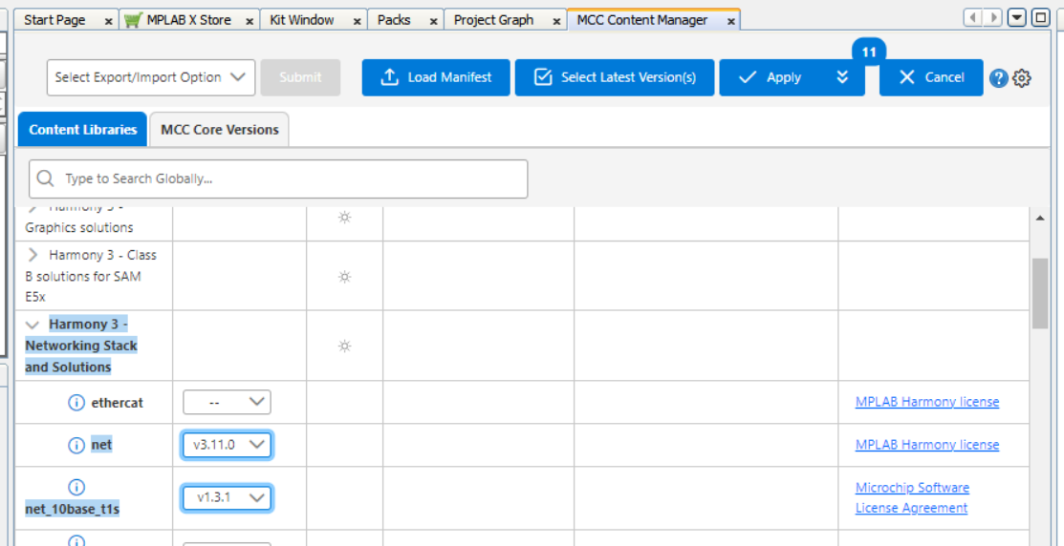
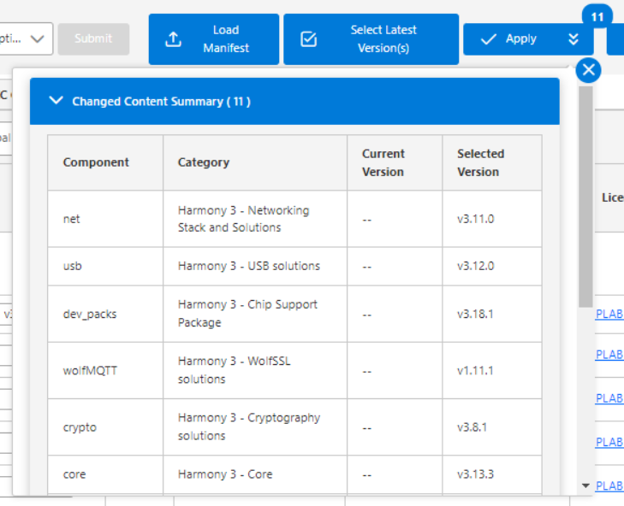
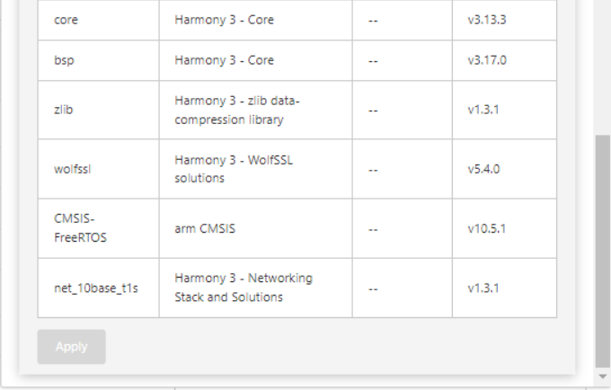
Select the Latest Versions of the Required Libraries
Select the latest versions for net and net_10base_t1s libraries.
Then you can see the libraries that these depend on – so these will be automatically included.
Select Apply to start the download for the libraries, this could take 30-60 minutes

Slide 15
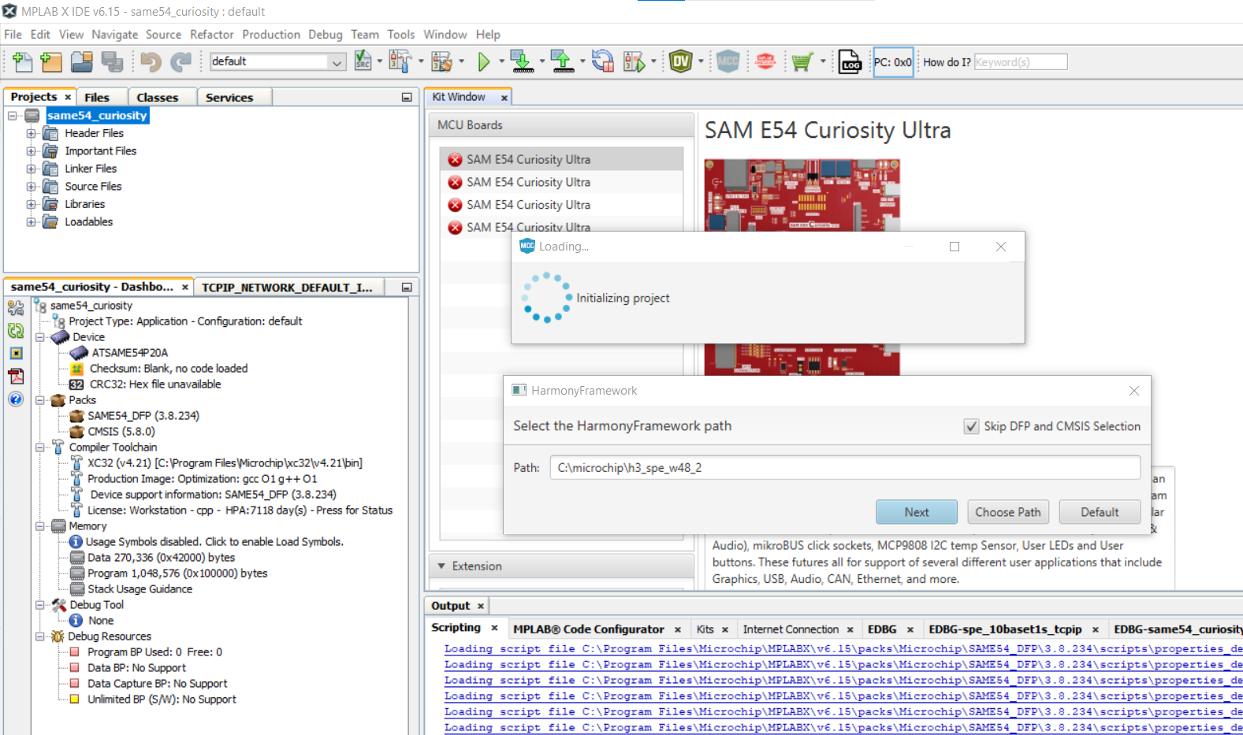

Step 11
Once the libraries have downloaded, the project should open in MCC automatically. If it doesn’t, then you can open MCC by clicking on the MCC button at the top of the MPLAB X window.
If the Harmony Framework path box appears, make sure that it has the same path that you specified originally for the project and for the Plugin Options in the earlier steps.

Slide 16
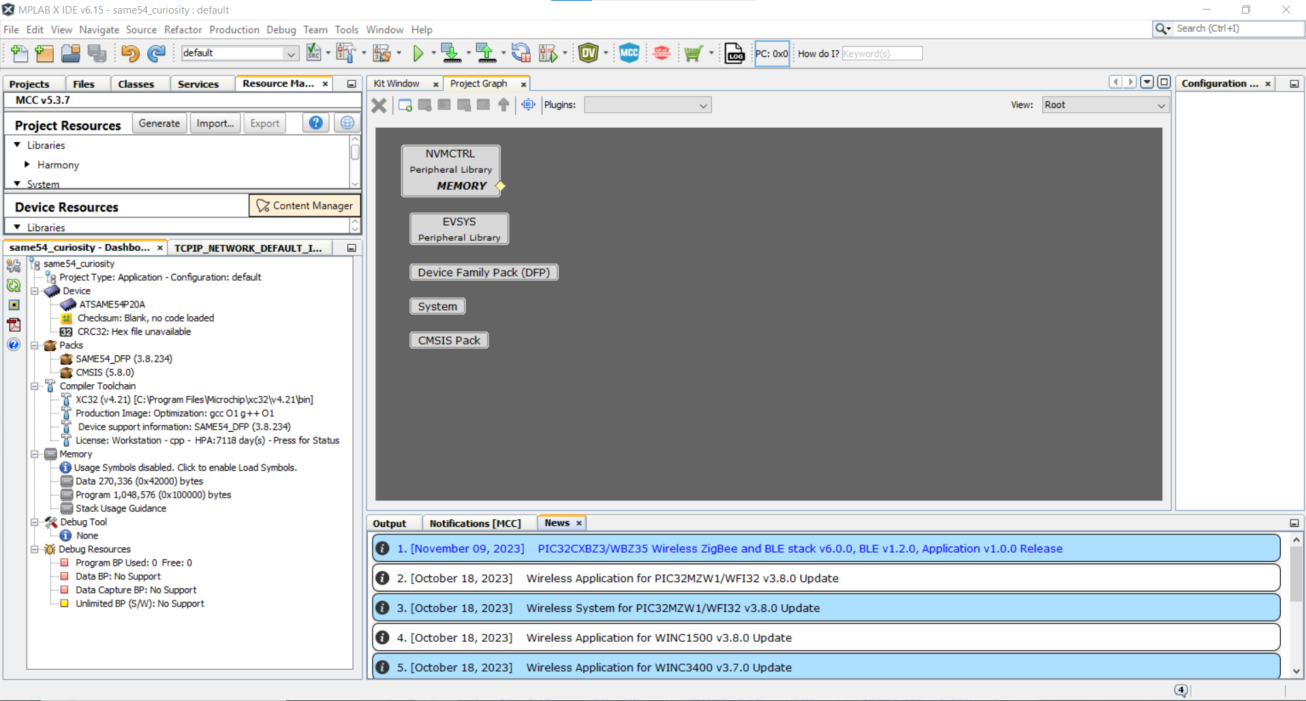
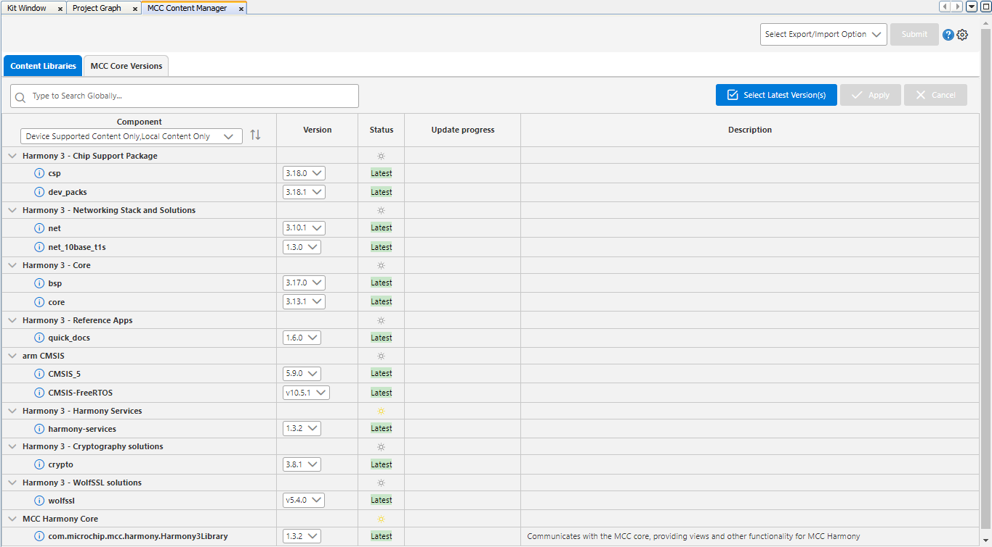
Step 12
Click on the “x” to close this view.
Open the Content Manager and view the packages that have been downloaded.
Tips:
Select Local Content so that you view just the libraries that you have downloaded rather than everything that was available for download
Use the down arrows beside the package headings to view all of the packages and versions

Slide 17
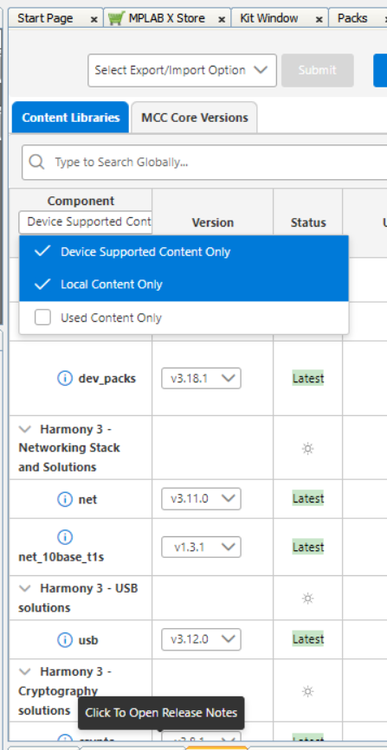
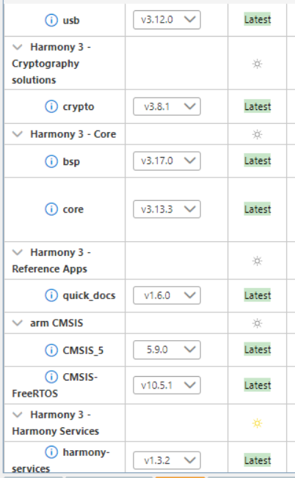
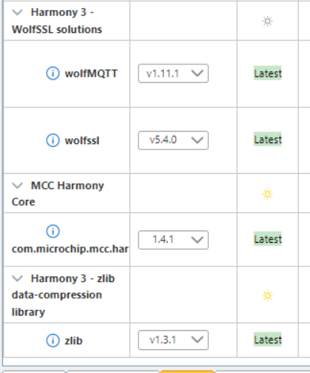
Check the libraries that have been downloaded

Slide 18
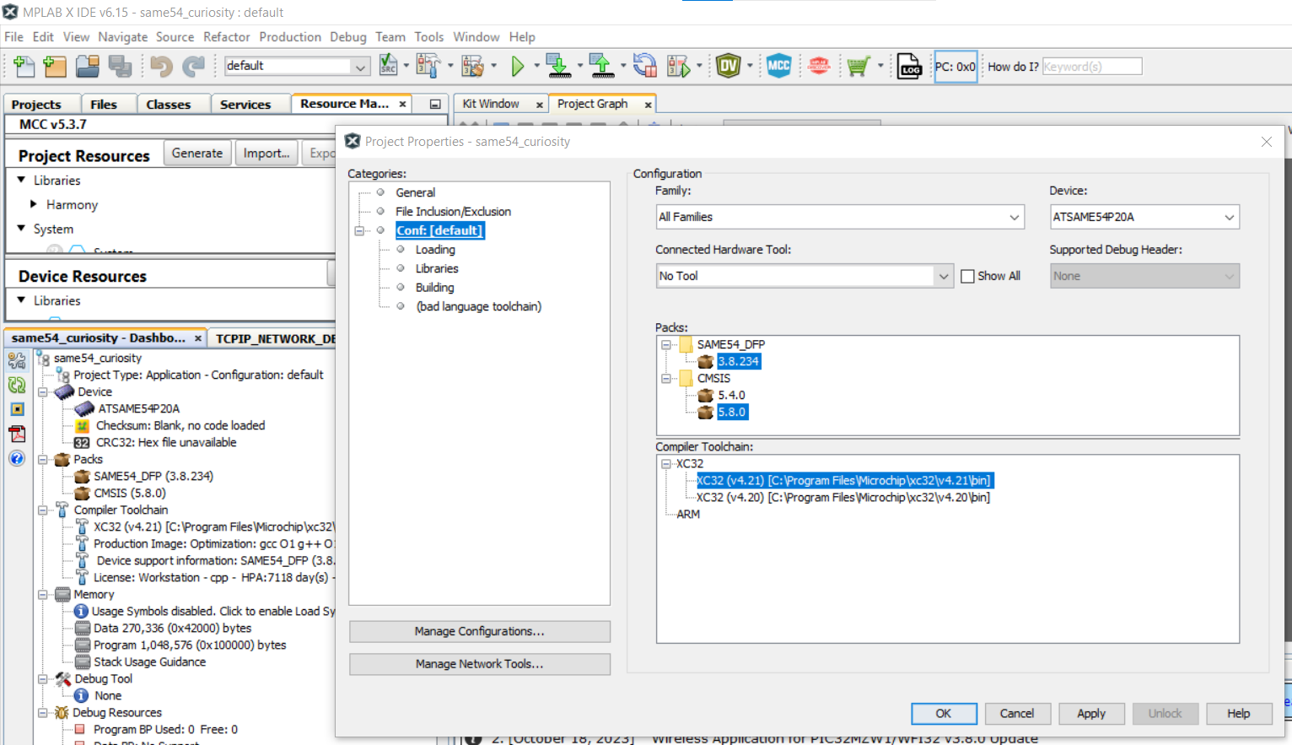
Step 13
Check that you have the most up-to-date Device Pack and that your XC32 compiler is included in the project. To do this, open the Project Properties and view the Packs and Compiler Toolchain.

Slide 19
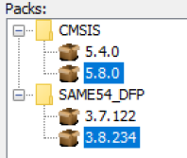
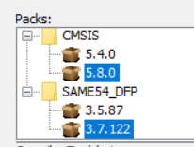
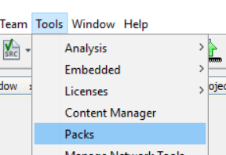
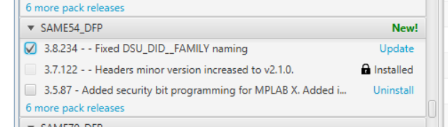
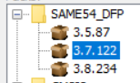
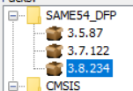
Step 13 (contd) Device Pack Update
If you don’t have the most up-to-date Device Pack installed, here is how to update it:
For example, if instead of 3.8.234,
you have 3.7.122
Go to Tools > Packs and search for “SAME54_DFP” and select the most recent version, and Update
Afterwards, change the version in the Project Properties
Open Project Properties
to change the version
->

Slide 20
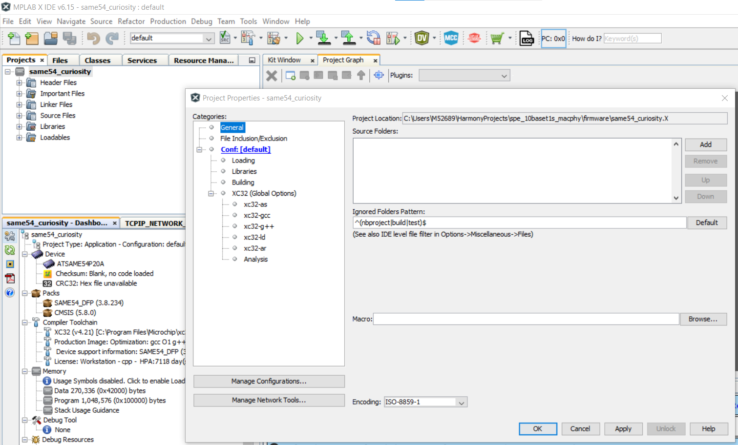
Step 14
Now you are all set! Take note of the location of your project, you can do this by opening the Project Properties and going to the General category, and viewing the Project Location.
You will be able to close the project now, and re-open when you need it.

Slide 21
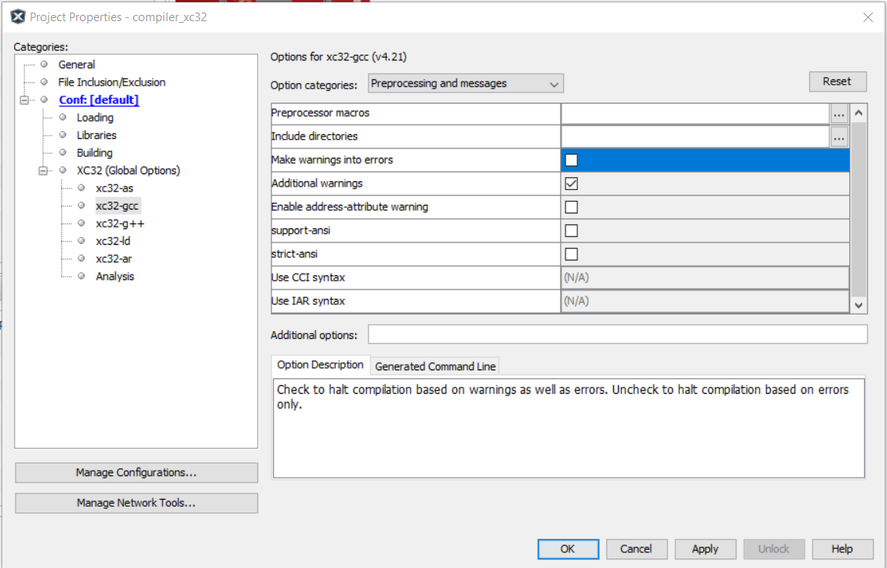
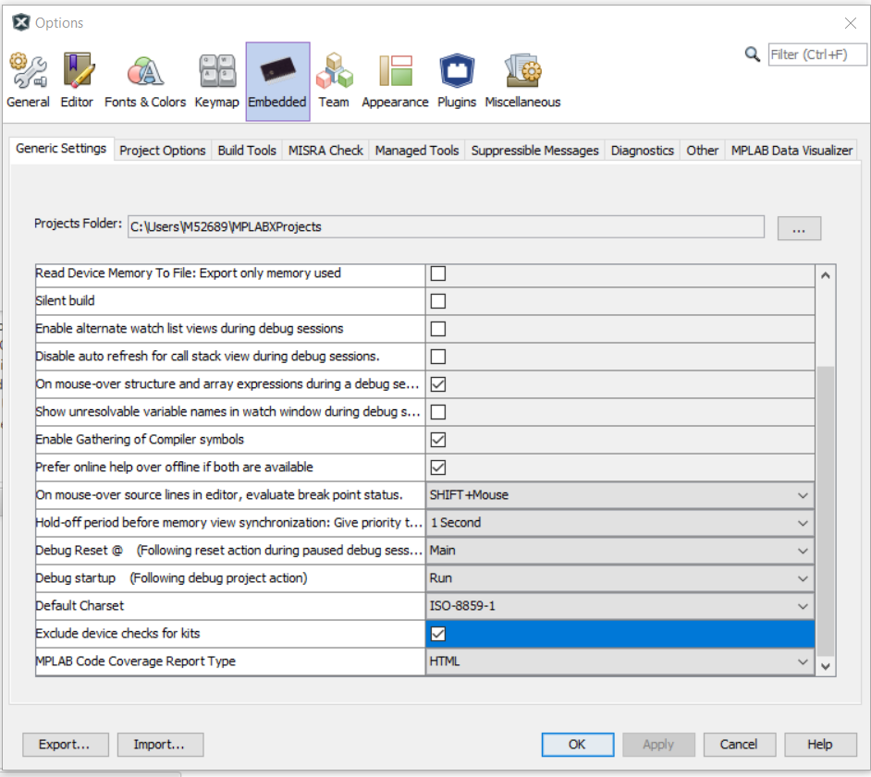
Additional settings that could cause problems!
In Project Properties, uncheck “Make warnings into errors”
In Options > Embedded, check “Exclude device checks for kits”

Slide 22
Useful Links and References

Slide 23
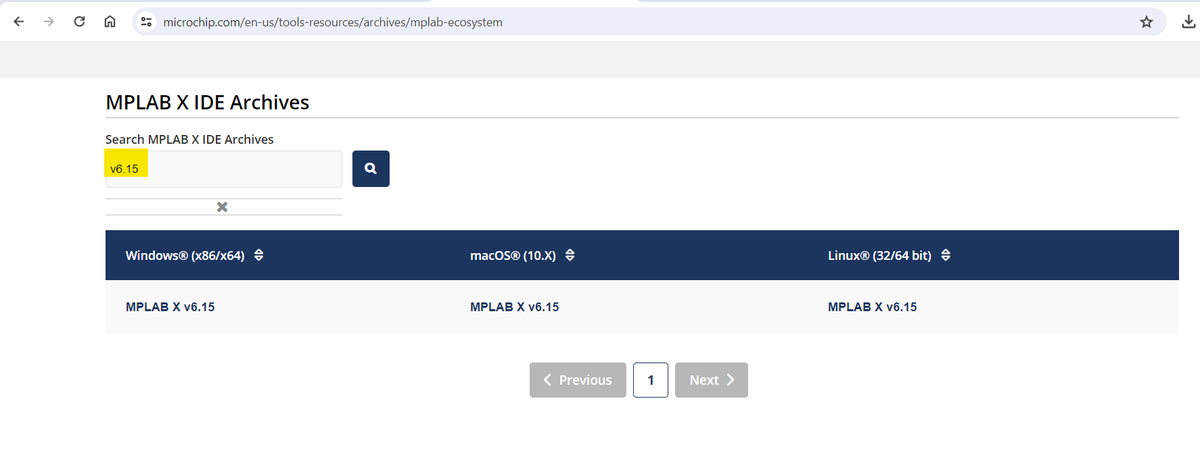
For more information…
For installing the necessary software, see:
These applications can now be downloaded from here:
https://www.microchip.com/en-us/tools-resources/develop
Make sure to download XC32 Compiler version 4.21 or later (this demo uses 4.21), as well as MPLAB X v6.15.
MPLAB X v6.15 is available here: https://www.microchip.com/en-us/tools-resources/archives/mplab-ecosystem:

Slide 24
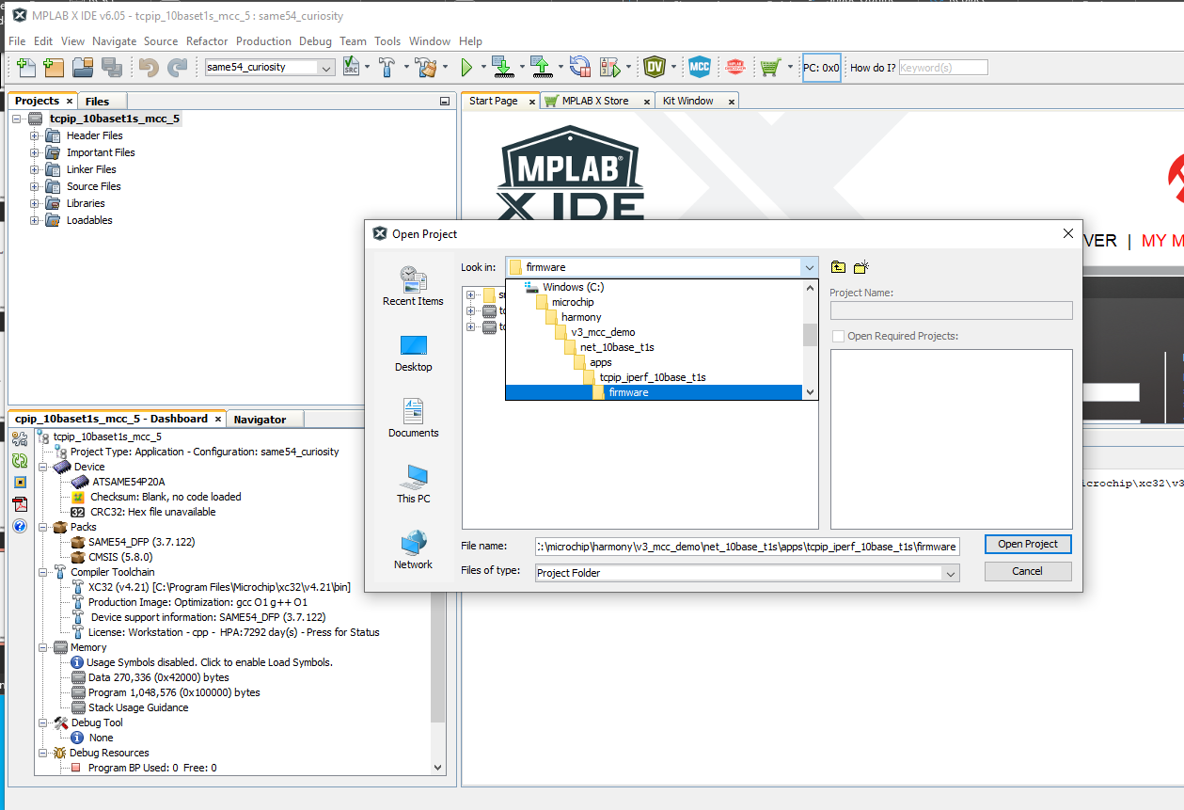
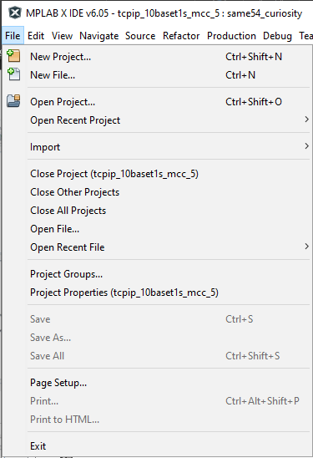
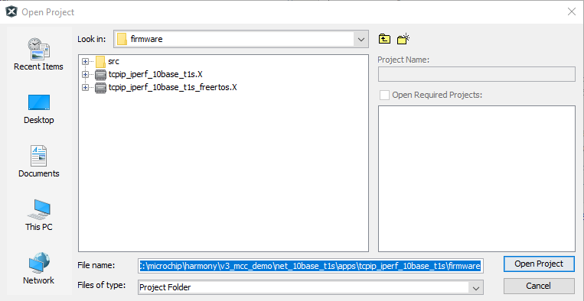
Demo Project
There is a demo project checked into the Github Harmony repository that you will have downloaded already in the net_10base_t1s library as part of the Optional Packages list during the project setup
Use File > Open Project and navigate to this library, and choose from the freertos or non-freertos versions
Note: in order to generate and compile these projects, you will still need to have downloaded the necessary packages as described in the project setup

